Slide 1
Multimedia Computing
By
Minhaz Uddin Ahmed, PhD
Department of Computer Engineering
Inha University Tashkent.
Email: minhaz.ahmed@gmail.com

Slide 2
Content
Differential Coding of Audio
Lossless Predictive Coding
DPCM
Lossless compression algorithms
Basics of Information Theory
Run length coding
Variable length coding
Shanon Fano algorithm
Huffman coding
Adaptive Huffman coding
LZW

Slide 3
Modulation
In electronics and telecommunications, modulation is the process of varying one or more properties of a periodic waveform, called the carrier signal, with a separate signal called the modulation signal that typically contains information to be transmitted.
Amplitude modulation (AM): The height of the signal carrier is varied to represent the data being added to the signal.
Frequency modulation (FM): The frequency of the carrier waveform is varied to reflect the frequency of the data.
Phase modulation (PM): The phase of the carrier waveform is varied to reflect changes in the frequency of the data. In PM, the frequency is unchanged while the phase is changed relative to the base carrier frequency. It is similar to FM.

Slide 4
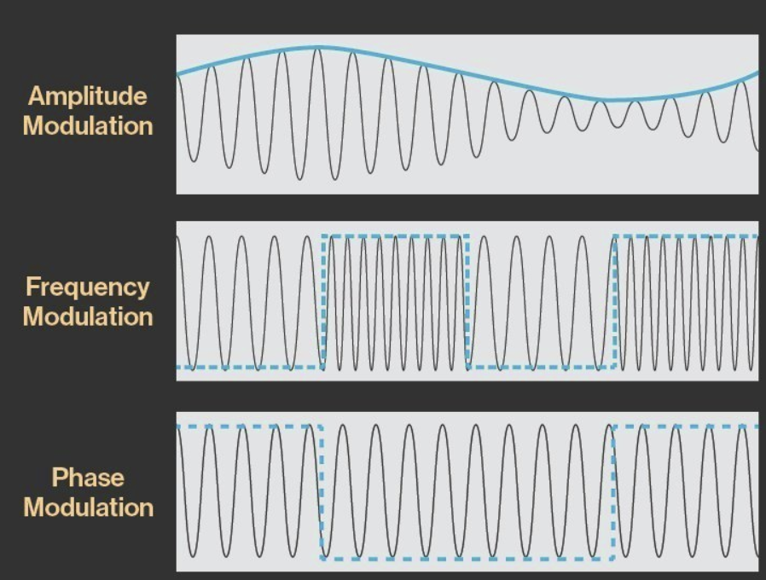
Modulation
Modulation is the process of encoding information in a transmitted signal, while demodulation is the process of extracting information from the transmitted signal

Slide 5
PCM in general
We say that the boundaries for quantizer input intervals that will all be mapped into the same output level form a coder mapping, and the representative values that are the output values from a quantizer are a decoder mapping.
Since we quantize, we may choose to create either an accurate or less accurate representation of sound magnitude values. Finally, we may wish to compress the data, by assigning a bitstream that uses fewer bits for the most prevalent signal values.

Slide 6
PCM in general
Every compression scheme has three stages:
1. Transformation. The input data is transformed to a new representation that is easier or more efficient to compress. For example, in Predictive Coding, we predict the next signal from previous ones and transmit the prediction error.
2. Loss. We may introduce loss of information. Quantization is the main lossy step. Here, we use a limited number of reconstruction levels fewer than in the original signal. Therefore, quantization necessitates some loss of information.
3. Coding. Here, we assign a codeword (thus forming a binary bitstream) to each output level or symbol. This could be a fixed-length code or a variable-length code, such as Huffman coding

Slide 7
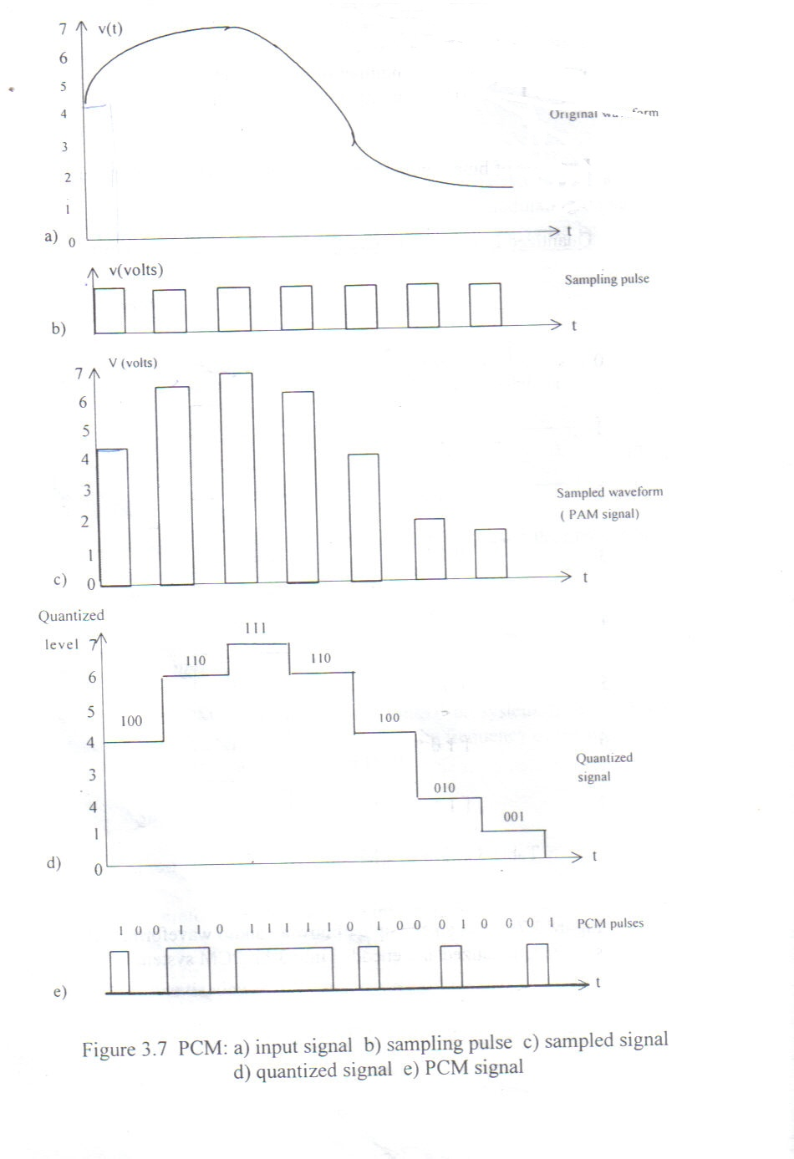
Shows an an audio waveform, v(t) is sampled, quantized and encoded into 3-bit PCM system

Slide 8
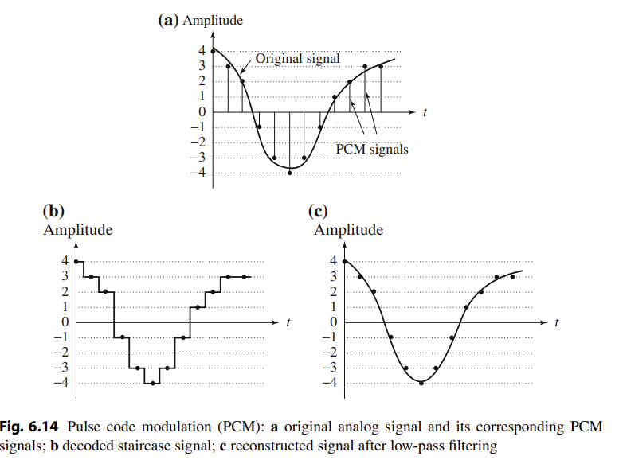
PCM in general

Slide 9
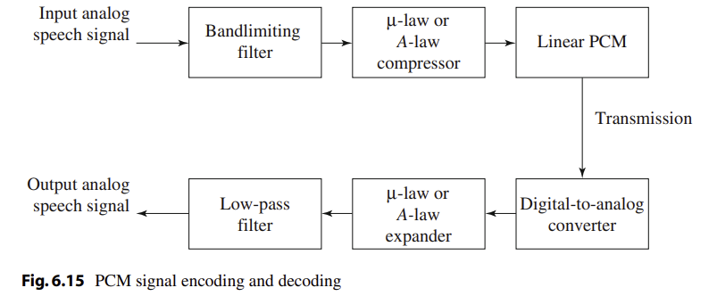
PCM in general

Slide 10
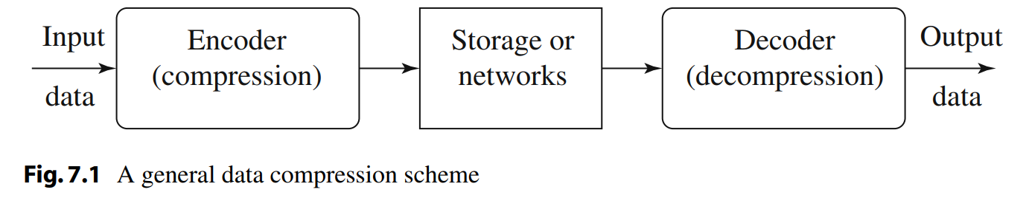
Compression technique
Compression: the process of coding that will effectively reduce the total number of bits needed to represent certain information.
If the compression and decompression processes induce no information loss, then the compression scheme is lossless; otherwise, it is lossy.

Slide 11
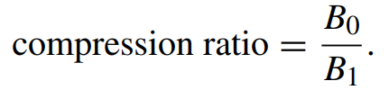
Lossless compression technique
lossless compression.
If the total number of bits required to represent the data before compression is B0 and the total number of bits required to represent the data after compression is B1, then we define the compression ratio as
we would desire any codec (encoder/decoder scheme) to have a compression ratio much larger than 1.0. The higher the compression ratio, the better the lossless compression scheme, as long as it is computationally feasible.

Slide 12
7.2 Basics of Information Theory
The entropy η of an information source with alphabet S = {s₁, s₂, . . . , s_{n}} is:
(7.2)
(7.3)
p_{i} – probability that symbol s_{i} will occur in S.
– indicates the amount of information ( self-information as defined by Shannon) contained in s_{i}, which corresponds to the number of bits needed to encode s_{i}.
Notes:
Entropy encoding is a lossless data compression technique that assigns shorter, variable-length codes to more frequent data symbols and longer codes to less frequent ones.

Slide 13
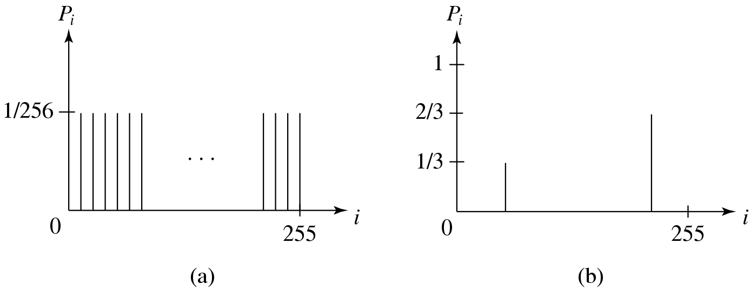
Distribution of Gray-Level Intensities
Fig. 7.2 Histograms for Two Gray-level Images.
Fig. 7.2(a) shows the histogram of an image with uniform distribution of gray-level intensities, i.e., ∀i p_{i} = 1/256. Hence, the entropy of this image is:
log₂256 = 8 (7.4)
Fig. 7.2(b) shows the histogram of an image with two possible values. Its entropy is 0.92.

Slide 14
7.3 Run-Length Coding
Memoryless Source: an information source that is independently distributed. Namely, the value of the current symbol does not depend on the values of the previously appeared symbols.
Instead of assuming memoryless source, Run-Length Coding (RLC) exploits memory present in the information source.
Rationale for RLC: if the information source has the property that symbols tend to form continuous groups, then such symbol and the length of the group can be coded.

Slide 15
LOSSLESS COMPRESSION
Run Length Encoding
It removes redundancy by relying on the fact that a string contains repeated sequences or “runs” of the same symbol. The runs of the same symbol are encoded using two entities—a count suggesting the number of repeated symbols and the symbol itself. For instance, a run of five symbols
aaaaa will be replaced by the two symbols 5a
example
BBBBEEEEEEEECCCCDAAAAA.
It can be represented as
4B8E4C1D5A.

Slide 16
Repetition Suppression
Repetition suppression works by reserving a specific symbol for a commonly occurring pattern in a message. For example, a specific series of successive occurrences of the letter a in the following example is replaced by the flag :
Abdcbaaaaaaaaaaaaaaaaaaaaaaaaaaaaaaaaaaaaaaaaaaaa
is replaced by
Abdcb.

Slide 17
Pattern Substitution
The compression is based on a simple idea that attempts to build a group of individual symbols into strings.
The strings are given a code, or an index, which is used every time the string appears in the input message. So, the whole message consisting of symbols is broken down into groups forming substrings, each substring having an index. Its simplicity resides in the fact that no pre-analysis of the message is required to create a dictionary of strings, but rather the strings are created as the message is scanned.

Slide 18
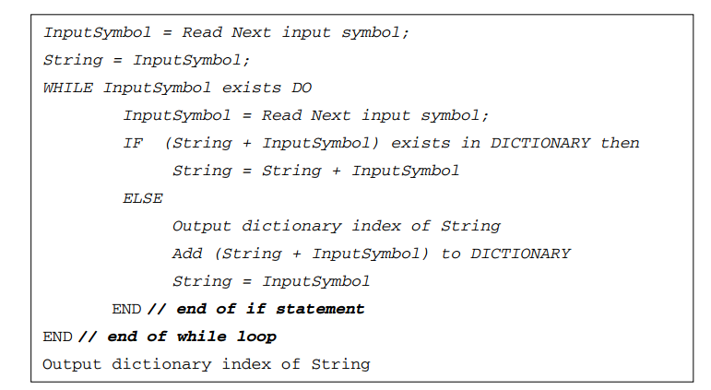
Pattern Substitution

Slide 19
7.4 Variable-Length Coding (VLC)
Shannon-Fano Algorithm — a top-down approach
1. Sort the symbols according to the frequency count of their occurrences.
2. Recursively divide the symbols into two parts, each with approximately the same number of counts, until all parts contain only one symbol.
An Example: coding of “HELLO”
Frequency count of the symbols in ”HELLO”.
Symbol | H E L O
Count | 1 1 2 1

Slide 20
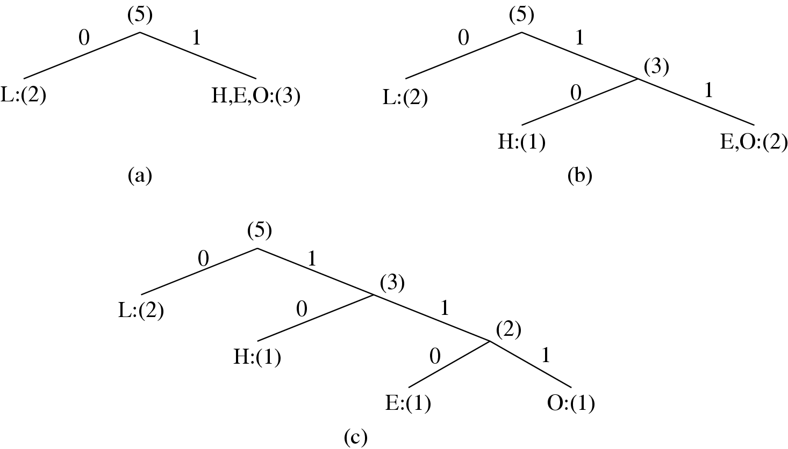
Fig. 7.3: Coding Tree for HELLO by Shannon-Fano.

Slide 21
Table 7.1: Result of Performing Shannon-Fano on HELLO
Symbol | Count | Log₂ | Code | # of bits used
L | 2 | 1.32 | 0 | 1
H | 1 | 2.32 | 10 | 2
E | 1 | 2.32 | 110 | 3
O | 1 | 2.32 | 111 | 3
TOTAL # of bits: |  |  |  | 10

Slide 22
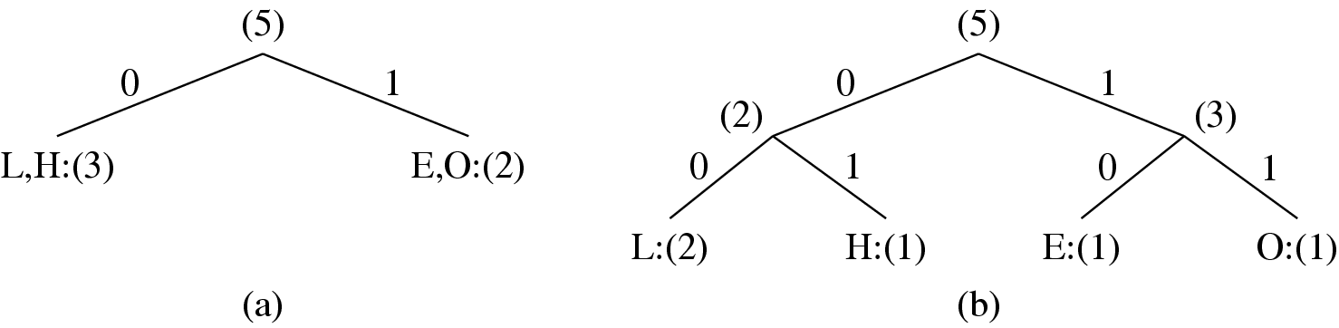
Fig. 7.4 Another coding tree for HELLO by Shannon-Fano.

Slide 23
Table 7.2: Another Result of Performing Shannon-Fano
on HELLO (see Fig. 7.4)
Symbol | Count | Log₂ | Code | # of bits used
L | 2 | 1.32 | 00 | 4
H | 1 | 2.32 | 01 | 2
E | 1 | 2.32 | 10 | 2
O | 1 | 2.32 | 11 | 2
TOTAL # of bits: |  |  |  | 10

Slide 24
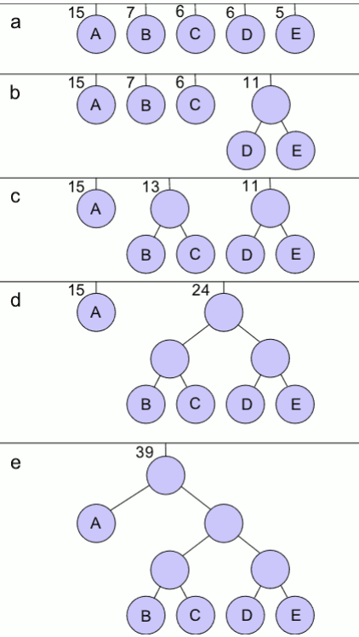

* Huffman Coding
When data is initially sampled, each sample is assigned the same number of bits. This length is log2n, where n is the number of distinct samples or quantization intervals.
Assigning an equal number of bits to all samples might not be the most efficient coding scheme because some symbols occur more commonly than others.

Slide 25
** Huffman Coding outline
1. The leaves of the binary tree are associated with the list of probabilities. The leaves can be sorted in increasing/decreasing order, though this is not necessary.
2. The two smallest probabilities are made sibling nodes by combining them under one new parent node with a probability equal to the sum of the child node probabilities.
3.Repeat the process by choosing two least probability nodes (which can be leaf nodes or new parent nodes) and combining them to form new parents until only one node is left. This forms the root node and results in a binary Huffman tree.
4.Label the branches with a 0 and 1 starting from the root and going to all intermediary nodes.

Slide 26
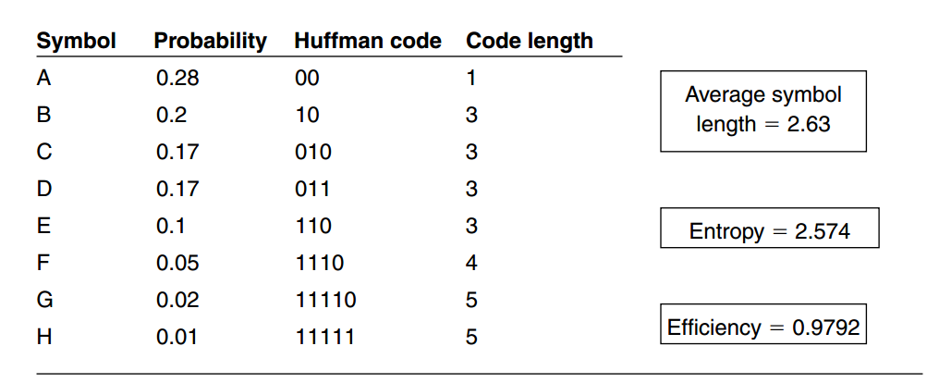
Huffman Coding outline
5 Traverse the Huffman tree from the root to a leaf node noting each branch label (1 or 0). This results in a Huffman code representation for that leaf node symbol. Perform the same for all the symbols.
Notes:
Write your Fisrt Name as string and apply Huffman coding algorithm and draw an equivalent binary tree.

Slide 27
Huffman Coding
ALGORITHM 7.1 Huffman Coding Algorithm— a bottom-up approach
1. Initialization: Put all symbols on a list sorted according to their frequency counts.
2. Repeat until the list has only one symbol left:
  (1) From the list pick two symbols with the lowest frequency counts. Form a Huffman subtree that has these two symbols as child nodes and create a parent node.
  (2) Assign the sum of the children’s frequency counts to the parent and insert it into the list such that the order is maintained.
  (3) Delete the children from the list.
3. Assign a codeword for each leaf based on the path from the root.

Slide 28
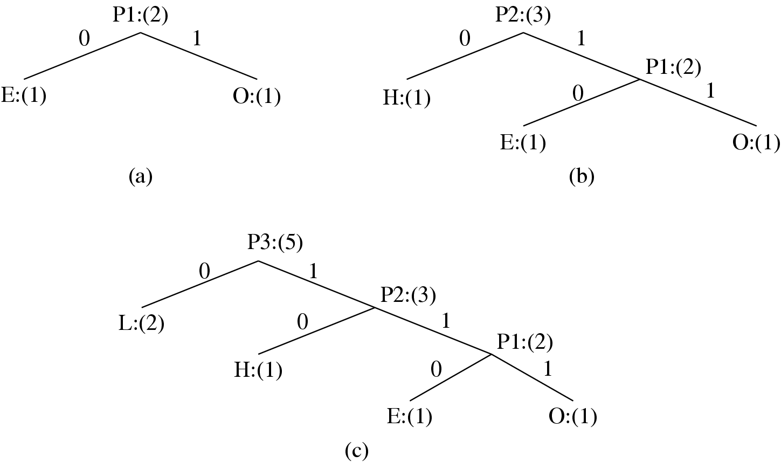
Fig. 7.5: Coding Tree for “HELLO” using the Huffman Algorithm.

Slide 29
Huffman Coding (cont’d)
In Fig. 7.5, new symbols P1, P2, P3 are created to refer to the parent nodes in the Huffman coding tree. The contents in the list are illustrated below:
  After initialization: L H E O
  After iteration (a): L P1 H
  After iteration (b): L P2
  After iteration (c): P3

Slide 30
Properties of Huffman Coding
1. Unique Prefix Property: No Huffman code is a prefix of any other Huffman code - precludes any ambiguity in decoding.
2. Optimality: minimum redundancy code - proved optimal for a given data model (i.e., a given, accurate, probability distribution):
  The two least frequent symbols will have the same length for their Huffman codes, differing only at the last bit.
  Symbols that occur more frequently will have shorter Huffman codes than symbols that occur less frequently.
  The average code length for an information source S is strictly less than η + 1. Combined with Eq. (7.5), we have:
(7.6)

Slide 31
Extended Huffman Coding
Motivation: All codewords in Huffman coding have integer bit lengths. It is wasteful when p_{i} is very large and hence is close to 0.
Why not group several symbols together and assign a single codeword to the group as a whole?
Extended Alphabet: For alphabet S = {s₁, s₂, . . . , s_{n}}, if k symbols are grouped together, then the extended alphabet is:
the size of the new alphabet S^{(k)} is n^{k}.

Slide 32
Extended Huffman Coding (cont’d)
It can be proven that the average # of bits for each symbol is:
(7.7)
An improvement over the original Huffman coding, but not much.
Problem: If k is relatively large (e.g., k ≥ 3), then for most practical applications where n ≫ 1, n^{k} implies a huge symbol table — impractical.

Slide 33
Adaptive Huffman Coding
Adaptive Huffman Coding: statistics are gathered and updated dynamically as the data stream arrives.
ENCODER ------- Initial_code(); while not EOF { get(c); encode(c); update_tree(c); } | DECODER ------- Initial_code(); while not EOF { decode(c); output(c); update_tree(c); }

Slide 34
Adaptive Huffman Coding (Cont’d)
Initial_code assigns symbols with some initially agreed upon codes, without any prior knowledge of the frequency counts.
update_tree constructs an Adaptive Huffman tree.
It basically does two things:
(a) increments the frequency counts for the symbols (including any new ones).
(b) updates the configuration of the tree.
The encoder and decoder must use exactly the same initial_code and update_tree routines.

Slide 35
Notes on Adaptive Huffman Tree Updating
Nodes are numbered in order from left to right, bottom to top. The numbers in parentheses indicates the count.
The tree must always maintain its sibling property, i.e., all nodes (internal and leaf) are arranged in the order of increasing counts.
If the sibling property is about to be violated, a swap procedure is invoked to update the tree by rearranging the nodes.
When a swap is necessary, the farthest node with count N is swapped with the node whose count has just been increased to
N +1.

Slide 36
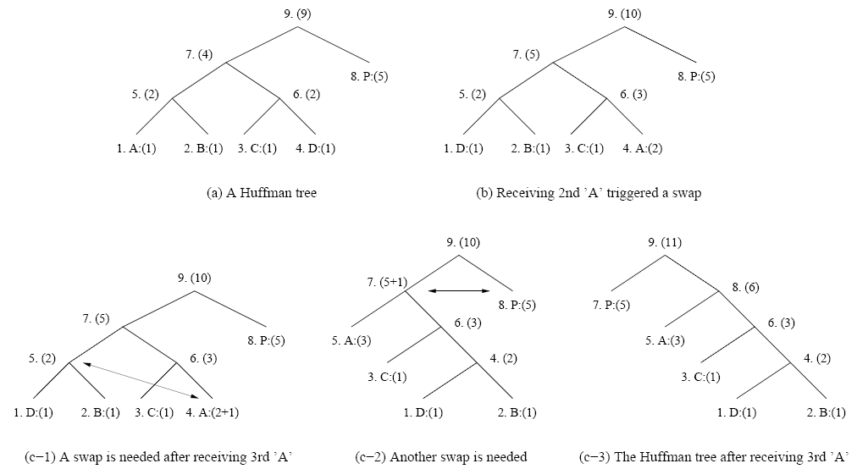
Fig. 7.6: Node Swapping for Updating an Adaptive Huffman Tree

Slide 37
7.5 Dictionary-based Coding
LZW uses fixed-length codewords to represent variable-length strings of symbols/characters that commonly occur together, e.g., words in English text.
the LZW encoder and decoder build up the same dictionary dynamically while receiving the data.
LZW places longer and longer repeated entries into a dictionary, and then emits the code for an element, rather than the string itself, if the element has already been placed in the dictionary.
Notes:
LZW (Lempel–Ziv–Welch)

Slide 38
Advantages of LZW over Huffman
LZW does not require any prior knowledge of the input data stream.
The LZW algorithm has a 60 - 70% compression ratio for some text files.
The LZW algorithm performs better for files with a lot of repetitive data.
The LZW algorithm compresses the data in a single pass

Slide 39
ALGORITHM 7.2 - LZW Compression
BEGIN
s = next input character;
while not EOF
{
c = next input character;
if s + c exists in the dictionary
s = s + c;
else
{
output the code for s;
add string s + c to the dictionary with a new code;
s = c;
}
}
output the code for s;
END

Slide 40
Example 7.2 LZW compression for string “ABABBABCABABBA”
Let’s start with a very simple dictionary (“string table”), initially containing only 3 characters, with codes as follows:
Now if the input string is “ABABBABCABABBA”, the LZW compression algorithm works as follows:
Code | String
1 | A
2 | B
3 | C

Slide 41
S | C | Output | Code | String
 |  |  | 1 2 3 | A B C
A B A AB B BA B C A AB A AB ABB A | B A B B A B C A B A B B A EOF | 1 2 4 5 2 3 4 6 1 | 4 5 6 7 8 9 10 11 | AB BA ABB BAB BC CA ABA ABBA
The output codes are: 1 2 4 5 2 3 4 6 1. Instead of sending 14 characters, only 9 codes need to be sent (compression ratio = 14/9 = 1.56).

Slide 42
ALGORITHM 7.3 LZW Decompression (simple version)
  BEGIN
  s = NIL;
  while not EOF
  {
  k = next input code;
  entry = dictionary entry for k;
  output entry;
  if (s != NIL)
  add string s + entry[0] to dictionary with a new code;
  s = entry;
  }
  END
Example 7.3: LZW decompression for string “ABABBABCABABBA”.
Input codes to the decoder are 1 2 4 5 2 3 4 6 1.
The initial string table is identical to what is used by the encoder.

Slide 43
The LZW decompression algorithm then works as follows:
S | K | Entry/output | Code | String
 |  |  | 1 2 3 | A B C
NIL A B AB BA B C AB ABB A | 1 2 4 5 2 3 4 6 1 EOF | A B AB BA B C AB ABB A | 4 5 6 7 8 9 10 11 | AB BA ABB BAB BC CA ABA ABBA
Apparently, the output string is “ABABBABCABABBA”, a truly lossless result!

Slide 44
ALGORITHM 7.4 LZW Decompression (modified)
BEGIN
  s = NIL;
  while not EOF
  {
  k = next input code;
  entry = dictionary entry for k;
  /* exception handler */
  if (entry == NULL)
  entry = s + s[0];
  output entry;
  if (s != NIL)
  add string s + entry[0] to dictionary with a new code;
  s = entry;
  }
END

Slide 45
LZW Coding (cont’d)
In real applications, the code length l is kept in the range of [l₀, l_{max}]. The dictionary initially has a size of 2^{l0}. When it is filled up, the code length will be increased by 1; this is allowed to repeat until l = l_{max}.
When l_{max} is reached and the dictionary is filled up, it needs to be flushed (as in Unix compress, or to have the LRU (least recently used) entries removed.

Slide 46

Reference
Chapter 7

Slide 47

Question

Slide 48

Thank you

